Slide 1
Predicting default on credit card debt
Jason Pizzollo
October 28, 2020

Slide 2
Kaggle Credit Risk Classification Dataset
Data: 30,000 customers
Features: 6 months credit card bill
6 months payment history
Age, Gender, Education Level, Marital Status
Label: Yes/ No (default)

Slide 3
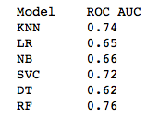
Random forest is the best of 6 simple models

Slide 4
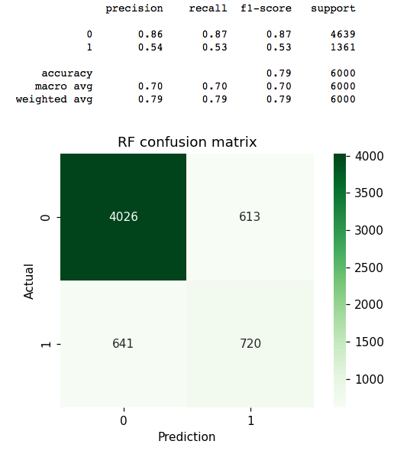
Optimization
Final Random Forest Model
Marginal accuracy improvement
Feature engineering (Debt = Bill - Payment)
Balance classes
Increase default predictions
Adjust prediction threshold

Slide 5
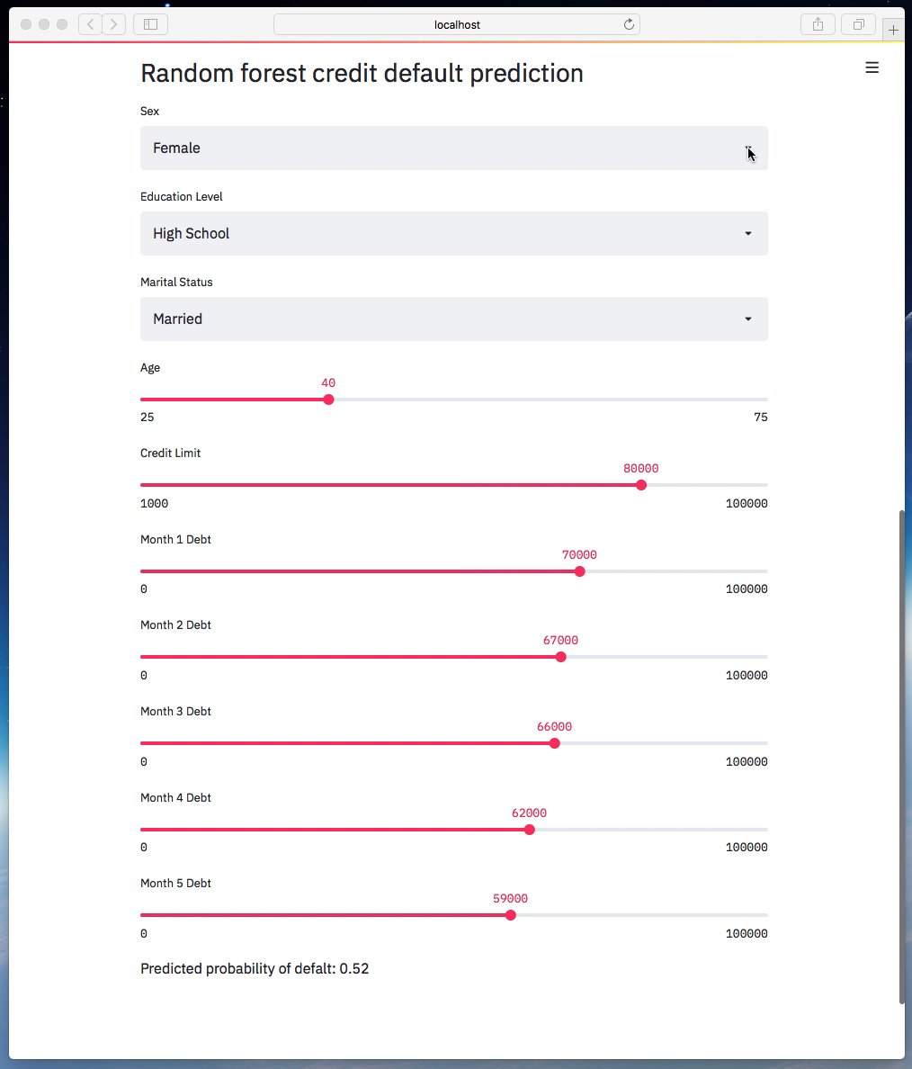
Prediction Tool

Slide 6
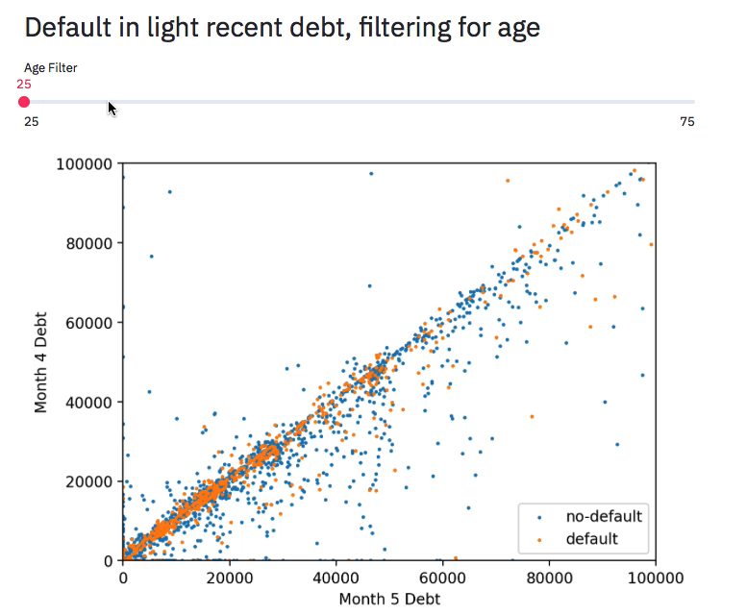
Visualizing Default ~ debt + age

Slide 7
How to predict default for customers with low debt?
Additional data would help:
Longer credit history
Credit score
Employment status
Income

Slide 8
Conclusions
Noisy data, but…
Good accuracy (~0.81) out of the box
Edge cases make predictions difficult
Next Steps
Making a better model:
Ensembling/ boosting/ stacking
Additional feature engineering (maybe)

